Slide 1
Introduction to Deep Learning Mechanisms
Week 5
Ph.D. Junetae, Kim
Assistant professor

Slide 2
Introduction to Deep Learning Mechanisms
Learning and optimization
Gradient descent algorithm
Multiple linear regression

Slide 3
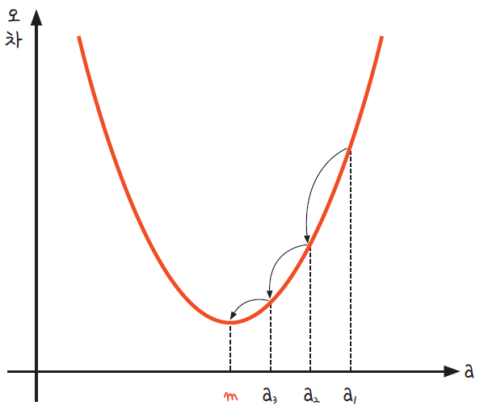
Introduction to Deep Learning Mechanisms
Introduction to gradient descent algorithm
The relationship in which the error increases to infinity when A increases to positive infinity or decreases to negative infinity can be expressed as a quadratic function.
This implies that the error can be minimized when A is properly optimized.
Error

Slide 4
Introduction to Deep Learning Mechanisms
Introduction to gradient descent algorithm
In order to find the value of m, it is necessary to take a random point (ex: a₁ ) and gradually move this point toward (a₁→ a₂→ a₃)
Error

Slide 5
Introduction to Deep Learning Mechanisms
Introduction to gradient descent algorithm
However, taking random points through numerous trials is very inefficient.
https://colab.research.google.com/github/JunetaeKim/DeepLearningClass/blob/main/Week5/W5_Simulation_simple.ipynb
Error

Slide 6
Introduction to Deep Learning Mechanisms
Introduction to gradient descent algorithm
Gradient descent algorithm is a method that updates a_{i} so that the error is smaller using the differential slope of the function.
Error

Slide 7
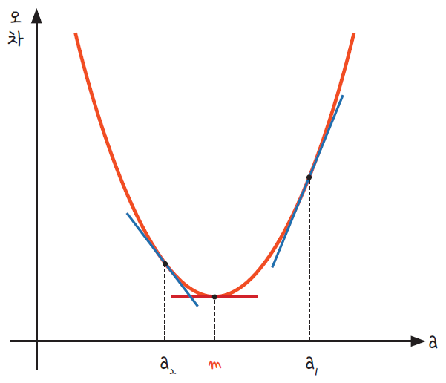
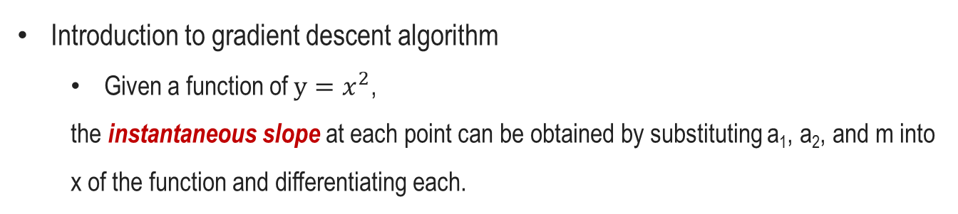
Introduction to Deep Learning Mechanisms
Introduction to gradient descent algorithm
Given a function of $y=x^{2}$,
the instantaneous slope at each point can be obtained by substituting a₁, a₂, and m into x of the function and differentiating each.
Error

Slide 8
Introduction to Deep Learning Mechanisms
Introduction to gradient descent algorithm
The point to note here is the minimum instantaneous slope at the value m.
Since the graph is a quadratic function, the slope of the parabola's vertices is a line parallel to the x-axis. (That is the slope is 0)
Therefore, we need to find the point A where the derivative is zero.
Error

Slide 9
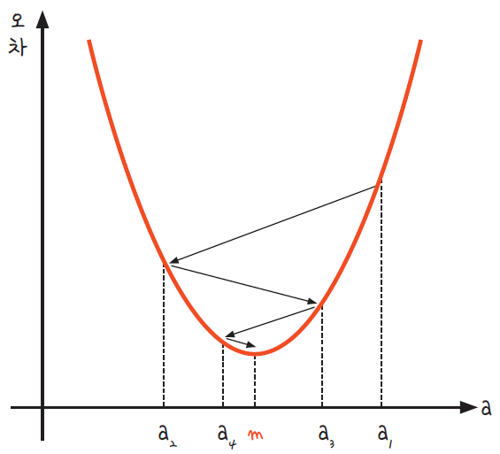
Introduction to Deep Learning Mechanisms
Mechanism of gradient descent algorithm
Calculating the derivative when x is a₁
Updating a₁ to a₂ in the opposite direction of the obtained gradient (negative if the gradient is +, positive if -)
Repeating the above process until the derivative value is less than a certain threshold.
Error

Slide 10
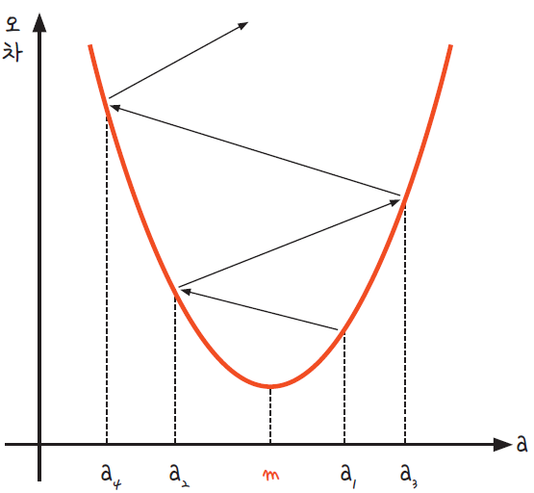
Introduction to Deep Learning Mechanisms
Potential problem of gradient descent algorithm
When updating a_{i} according to the slope, if a_{i} moves too much, it diverges as shown below.
That is, if the learning rate is too large, it diverges instead of converging to a point.
To address this problem, a parameter called the learning rate needs to be introduced.
Error

Slide 11
Introduction to Deep Learning Mechanisms
Introduction to learning rate
The learning rate is an exogenous hyperparameter that determines how much to update.
Setting the optimal learning rate while appropriately adjusting the values ​​is one of the important optimization tasks in deep learning.
Error

Slide 12
Introduction to Deep Learning Mechanisms
Summary of gradient descent
The process of updating a_{i} so that the derivative is minimized by setting an appropriate learning rate, when there is a function whose error depends on the parameter a_{i}.
The y-intercept b_{i} is also estimated by the same mechanism.
Similarly, if the value of b is too large, the error increases, and if the value of b is too small, the error increases.
Error

Slide 13
Introduction to Deep Learning Mechanisms
Components required for gradient descent update
Partial derivative of MSE with respect to both a and b, respectively
Learning rate
Updating equation

Slide 14
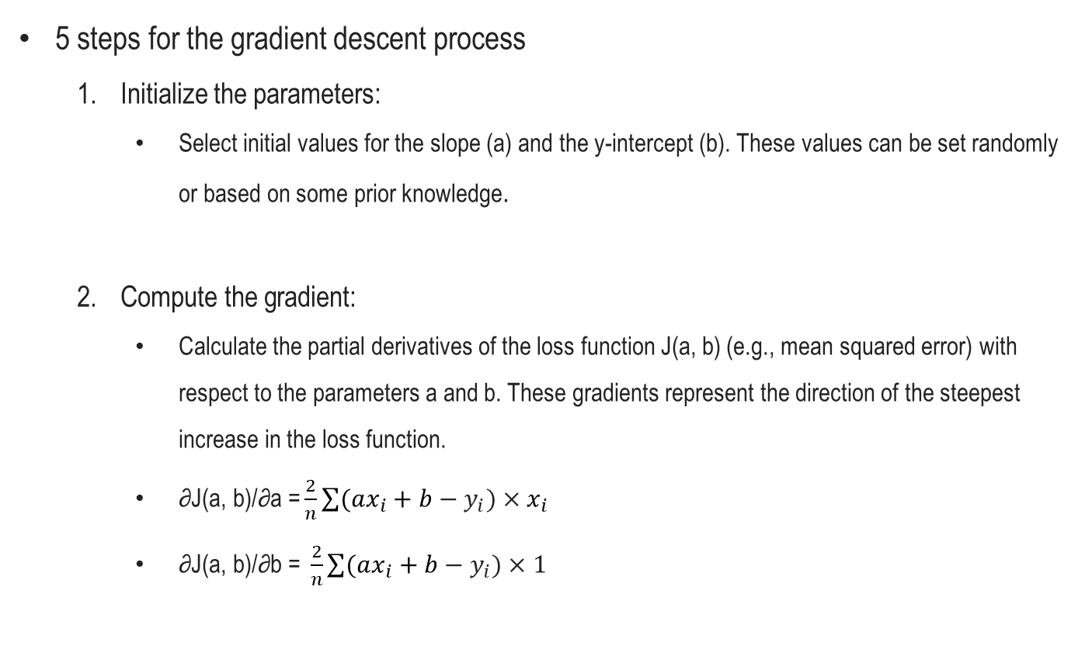
Introduction to Deep Learning Mechanisms
5 steps for the gradient descent process
Initialize the parameters:
Select initial values for the slope (a) and the y-intercept (b). These values can be set randomly or based on some prior knowledge.
Compute the gradient:
Calculate the partial derivatives of the loss function J(a, b) (e.g., mean squared error) with respect to the parameters a and b. These gradients represent the direction of the steepest increase in the loss function.
$\text{∂}\text{J}\text{(}\text{a}\text{, }\text{b}\text{)/∂}\text{a}\text{ =}\frac{2}{n}\sum{(ax_{i}+b−y_{i})×x_{i}}$
$\text{∂}\text{J}\text{(}\text{a}\text{, }\text{b}\text{)/∂}\text{b}\text{ = }\frac{2}{n}\sum{(ax_{i}+b−y_{i})×1}$

Slide 15
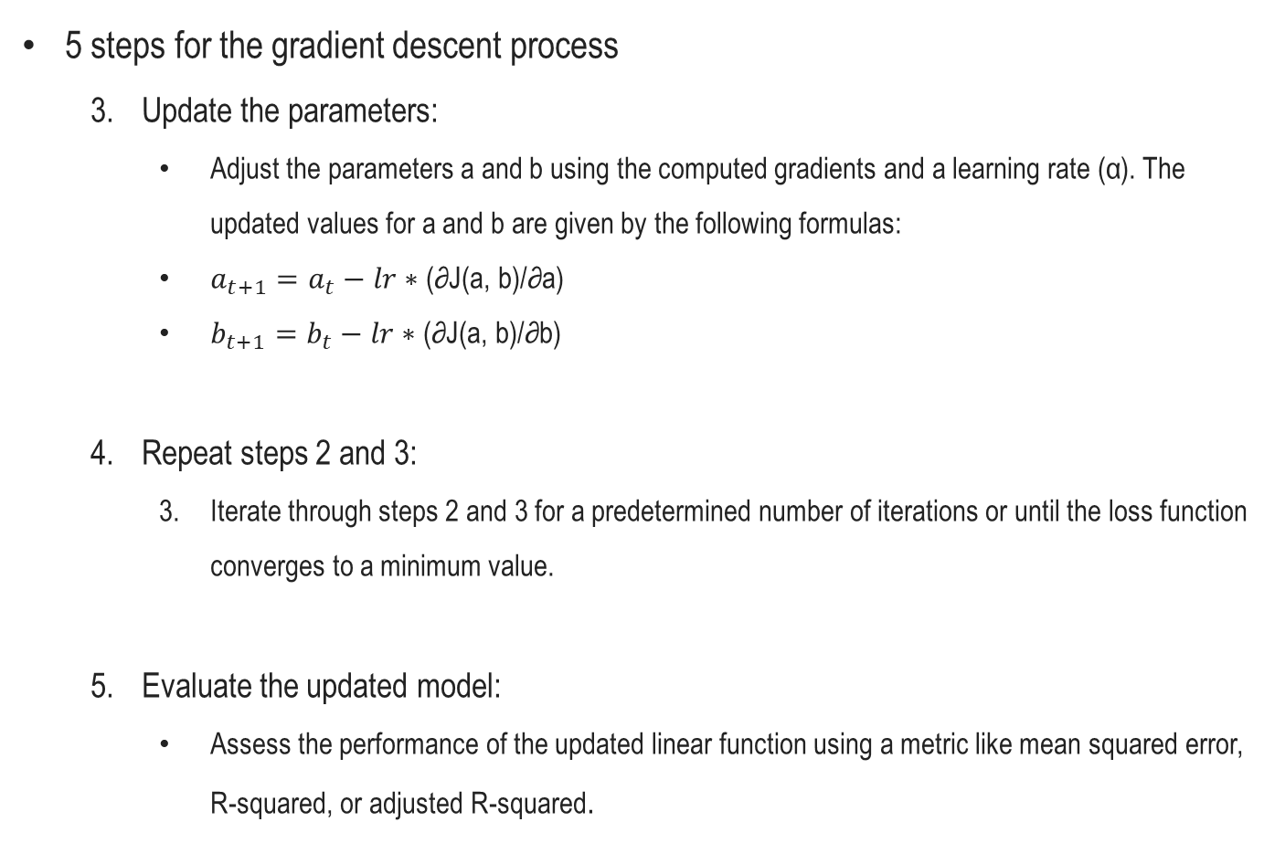
Introduction to Deep Learning Mechanisms
5 steps for the gradient descent process
Update the parameters:
Adjust the parameters a and b using the computed gradients and a learning rate (α). The updated values for a and b are given by the following formulas:
$a_{t+1}=a_{t}−lr∗\text{(∂}\text{J}\text{(}\text{a}\text{, }\text{b}\text{)/∂}\text{a}\text{)}$
$b_{t+1}=b_{t}−lr∗\text{(∂}\text{J}\text{(}\text{a}\text{, }\text{b}\text{)/∂}\text{b}\text{)}$
Repeat steps 2 and 3:
Iterate through steps 2 and 3 for a predetermined number of iterations or until the loss function converges to a minimum value.
Evaluate the updated model:
Assess the performance of the updated linear function using a metric like mean squared error, R-squared, or adjusted R-squared.

Slide 16
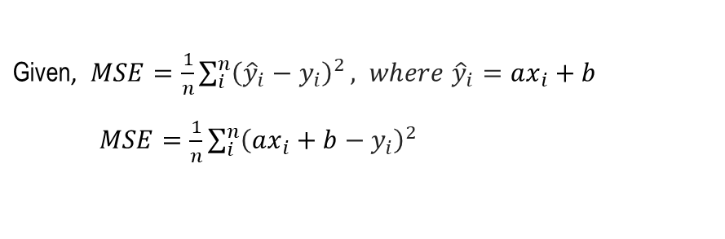
Introduction to Deep Learning Mechanisms
Partial derivative of MSE with respect to a
Given, $MSE=\frac{1}{n}\sum_{i}^{n}{{\left({\hat{y}}_{i}−y_{i}\right)}^{2}}, where {\hat{y}}_{i}=ax_{i}+b$
$MSE=\frac{1}{n}\sum_{i}^{n}{{\left(ax_{i}+b−y_{i}\right)}^{2}}$

Slide 17
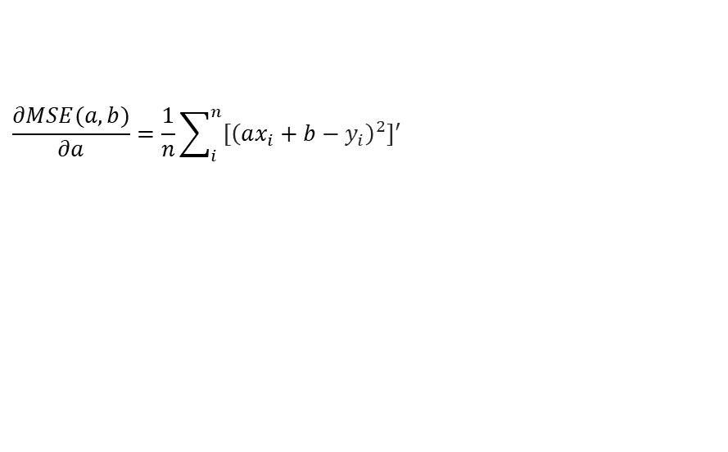
Introduction to Deep Learning Mechanisms
Partial derivative of MSE with respect to a
Given, $MSE=\frac{1}{n}\sum_{i}^{n}{{\left({\hat{y}}_{i}−y_{i}\right)}^{2}}, where {\hat{y}}_{i}=ax_{i}+b$
$MSE=\frac{1}{n}\sum_{i}^{n}{{\left(ax_{i}+b−y_{i}\right)}^{2}}$
$$\frac{∂MSE(a,b)}{∂a}=\frac{1}{n}\sum_{i}^{n}{{{[\left(ax_{i}+b−y_{i}\right)}^{2}]}^{′}}$$

Slide 18
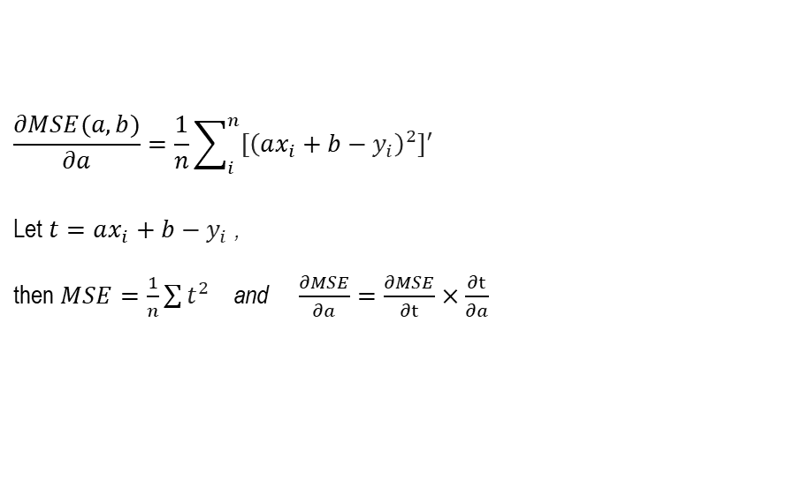
Introduction to Deep Learning Mechanisms
Partial derivative of MSE with respect to a
Given, $MSE=\frac{1}{n}\sum_{i}^{n}{{\left({\hat{y}}_{i}−y_{i}\right)}^{2}}, where {\hat{y}}_{i}=ax_{i}+b$
$MSE=\frac{1}{n}\sum_{i}^{n}{{\left(ax_{i}+b−y_{i}\right)}^{2}}$
$$\frac{∂MSE(a,b)}{∂a}=\frac{1}{n}\sum_{i}^{n}{{{[\left(ax_{i}+b−y_{i}\right)}^{2}]}^{′}}$$
Let $t=ax_{i}+b−y_{i}$ ,
then $MSE=\frac{1}{n}\sum{t^{2}}$ and $\frac{∂MSE}{∂a}=\frac{∂MSE}{∂t}×\frac{∂t}{∂a}$

Slide 19
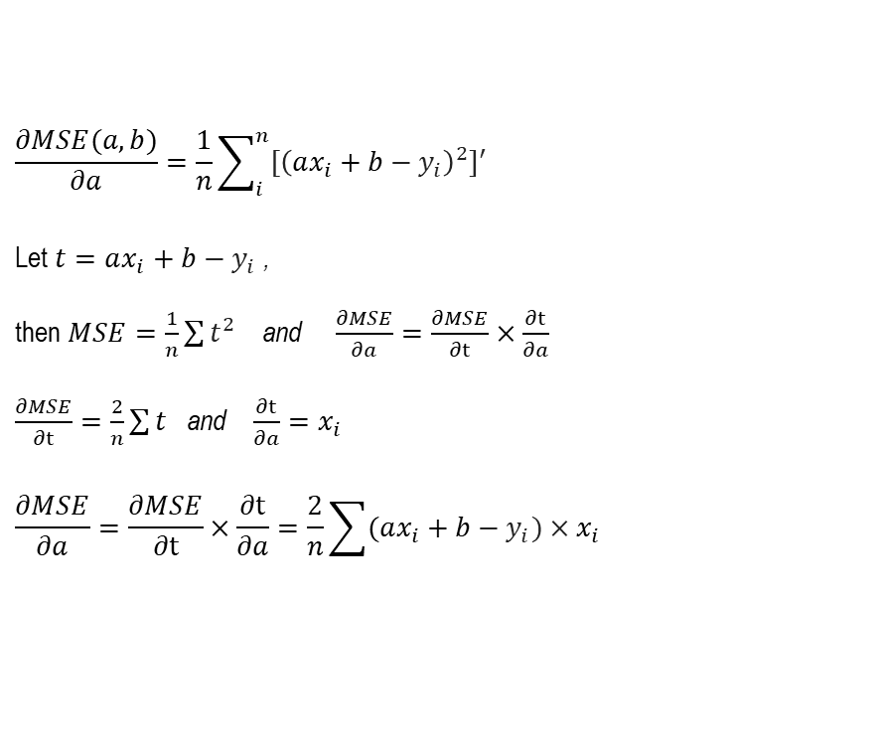
Introduction to Deep Learning Mechanisms
Partial derivative of MSE with respect to a
Given, $MSE=\frac{1}{n}\sum_{i}^{n}{{\left({\hat{y}}_{i}−y_{i}\right)}^{2}}, where {\hat{y}}_{i}=ax_{i}+b$
$MSE=\frac{1}{n}\sum_{i}^{n}{{\left(ax_{i}+b−y_{i}\right)}^{2}}$
$$\frac{∂MSE(a,b)}{∂a}=\frac{1}{n}\sum_{i}^{n}{{{[\left(ax_{i}+b−y_{i}\right)}^{2}]}^{′}}$$
Let $t=ax_{i}+b−y_{i}$ ,
then $MSE=\frac{1}{n}\sum{t^{2}}$ and $\frac{∂MSE}{∂a}=\frac{∂MSE}{∂t}×\frac{∂t}{∂a}$
$\frac{∂MSE}{∂t}=\frac{2}{n}\sum{t}$ and $\frac{∂t}{∂a}=x_{i}$
$$\frac{∂MSE}{∂a}=\frac{∂MSE}{∂t}×\frac{∂t}{∂a}=\frac{2}{n}\sum{(ax_{i}+b−y_{i})×x_{i}}$$

Slide 20

Introduction to Deep Learning Mechanisms
Partial derivative of MSE with respect to b (exercise for students)
Given, $MSE=\frac{1}{n}\sum_{i}^{n}{{\left({\hat{y}}_{i}−y_{i}\right)}^{2}}, where {\hat{y}}_{i}=ax_{i}+b$
$MSE=\frac{1}{n}\sum_{i}^{n}{{\left(ax_{i}+b−y_{i}\right)}^{2}}$
$$\frac{∂MSE(a,b)}{∂b}=\frac{1}{n}\sum_{i}^{n}{{{[\left(ax_{i}+b−y_{i}\right)}^{2}]}^{′}}$$

Slide 21

Introduction to Deep Learning Mechanisms
Partial derivative of MSE with respect to b (solution)
Given, $MSE=\frac{1}{n}\sum_{i}^{n}{{\left({\hat{y}}_{i}−y_{i}\right)}^{2}}, where {\hat{y}}_{i}=ax_{i}+b$
$MSE=\frac{1}{n}\sum_{i}^{n}{{\left(ax_{i}+b−y_{i}\right)}^{2}}$
$$\frac{∂MSE(a,b)}{∂b}=\frac{1}{n}\sum_{i}^{n}{{{[\left(ax_{i}+b−y_{i}\right)}^{2}]}^{′}}$$
Let $t=ax_{i}+b−y_{i}$ ,
then $MSE=\frac{1}{n}\sum{t^{2}}$ and $\frac{∂MSE}{∂b}=\frac{∂MSE}{∂t}×\frac{∂t}{∂b}$
$\frac{∂MSE}{∂t}=\frac{2}{n}\sum{t}$ and $\frac{∂t}{∂b}=1$
$$\frac{∂MSE}{∂b}=\frac{∂MSE}{∂t}×\frac{∂t}{∂b}=\frac{2}{n}\sum{(ax_{i}+b−y_{i})×1}$$

Slide 22
Introduction to Deep Learning Mechanisms
Coding exercise for GD with a linear regression
https://colab.research.google.com/github/JunetaeKim/DeepLearningClass/blob/main/Week5/W5_GradientDecsent_simple.ipynb

Slide 23
Introduction to Deep Learning Mechanisms
Multiple linear regression

Slide 24
Introduction to Deep Learning Mechanisms
Introduction to multiple linear regression
A model in which two or more independent variables are employed to predict or explain the dependent variable.
The greater the amount of information input, the better the predictive power of the model.

Slide 25
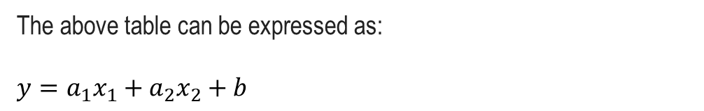
Introduction to Deep Learning Mechanisms
Example of multiple linear regression
Study hours: x₁ | 2 | 4 | 6 | 8
number of private tutoring: x₂ | 0 | 4 | 2 | 3
Scores: y | 81 | 93 | 91 | 97
The above table can be expressed as:
$$y=a_{1}x_{1}+a_{2}x_{2}+b$$

Slide 26
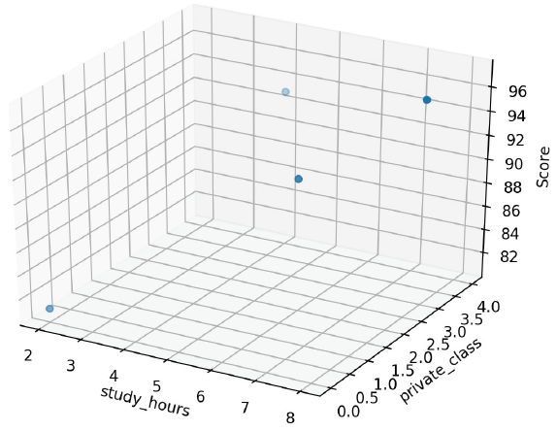
Introduction to Deep Learning Mechanisms
Example of multiple linear regression
Study hours: x₁ | 2 | 4 | 6 | 8
number of private tutoring: x₂ | 0 | 4 | 2 | 3
Scores: y | 81 | 93 | 91 | 97
The association among data in the above table can be visualized as:

Slide 27
Introduction to Deep Learning Mechanisms
Coding exercise for GD with a multiple linear regression
https://colab.research.google.com/github/JunetaeKim/DeepLearningClass/blob/main/Week5/W5_GradientDecsent_multiple.ipynb

Slide 28
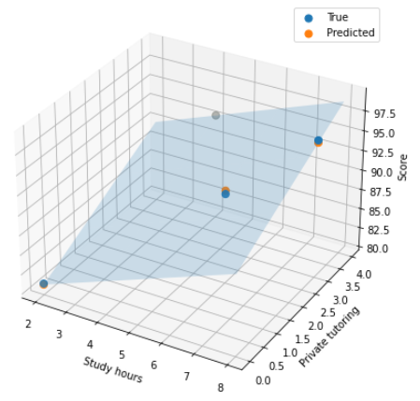
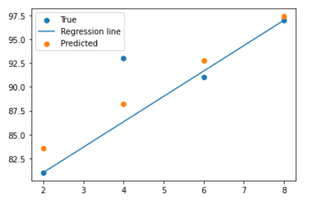
Introduction to Deep Learning Mechanisms
Interpretation of visualization
A 2d prediction line is replaced with a 3d prediction ‘plane’
Since the values predicted based on a linear line are now predicted based on a wider plane, more accurate prediction is possible.

Slide 29
Introduction to Deep Learning Mechanisms
Logistic regression

Slide 30
Introduction to Deep Learning Mechanisms
Introduction to logistic regression
Logistic regression estimates the probability of an event occurring, such as voted or didn’t vote, based on a given dataset of independent variables.
Since the outcome is a probability, the dependent variable is bounded between 0 and 1.
Therefore, it is not suitable for solving problems with linear lines.

Slide 31
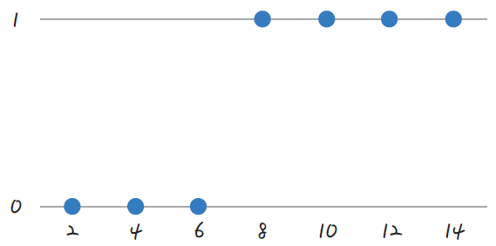
Introduction to Deep Learning Mechanisms
Example of logistic regression
Study hours: x₁ | 2 | 4 | 6 | 8 | 10 | 12 | 14
Pass = 1 vs Fail = 0 | 0 | 0 | 0 | 1 | 1 | 1 | 1
Let the pass be 1 and the fail be 0, and when expressed on the coordinate plane, it is as shown in the figure.

Slide 32
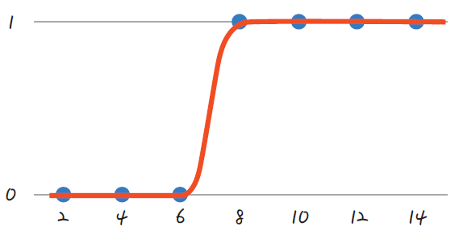
Introduction to Deep Learning Mechanisms
Example of logistic regression
Study hours: x₁ | 2 | 4 | 6 | 8 | 10 | 12 | 14
Pass = 1 vs Fail = 0 | 0 | 0 | 0 | 1 | 1 | 1 | 1
Since these points only have values ​​of 1 and 0, it is difficult to draw a linear line.
Therefore, an s-shaped line is required rather than a linear line.

Slide 33
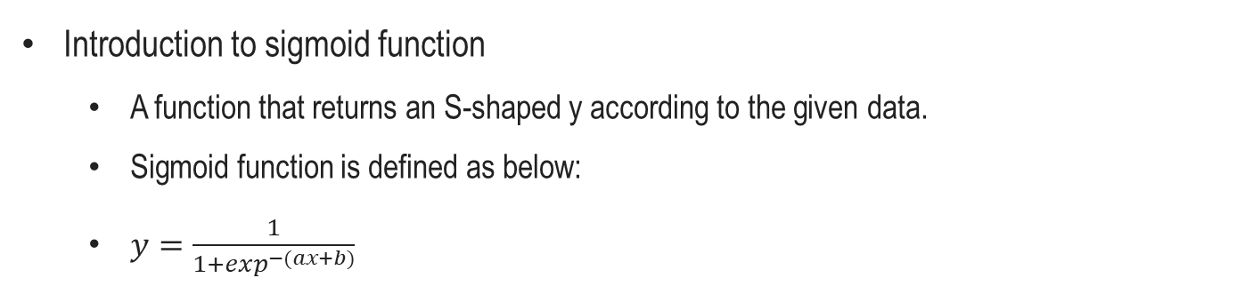
Introduction to Deep Learning Mechanisms
Introduction to sigmoid function
A function that returns an S-shaped y according to the given data.
Sigmoid function is defined as below:
$y=\frac{1}{1+\exp^{−(ax+b)}}$

Slide 34
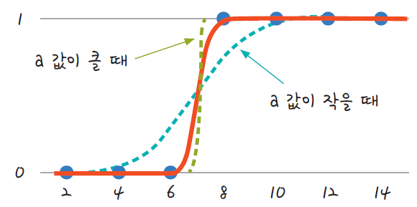
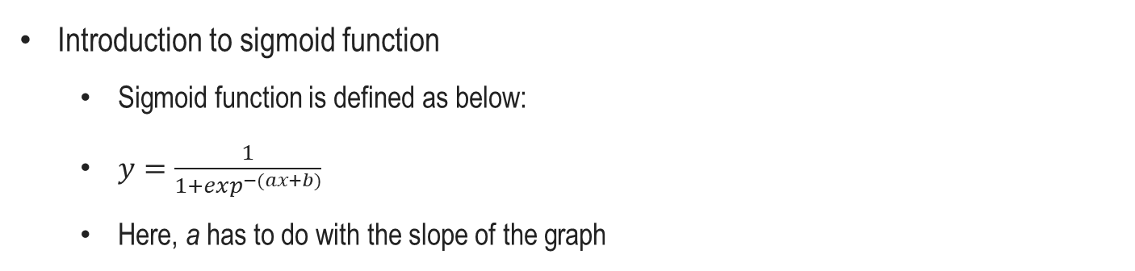
Introduction to Deep Learning Mechanisms
Introduction to sigmoid function
Sigmoid function is defined as below:
$y=\frac{1}{1+\exp^{−(ax+b)}}$
Here, a has to do with the slope of the graph
when a is large
when a is small

Slide 35
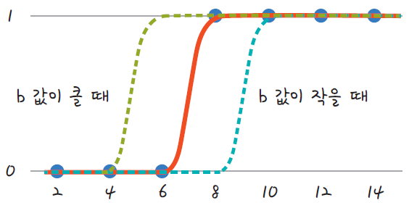
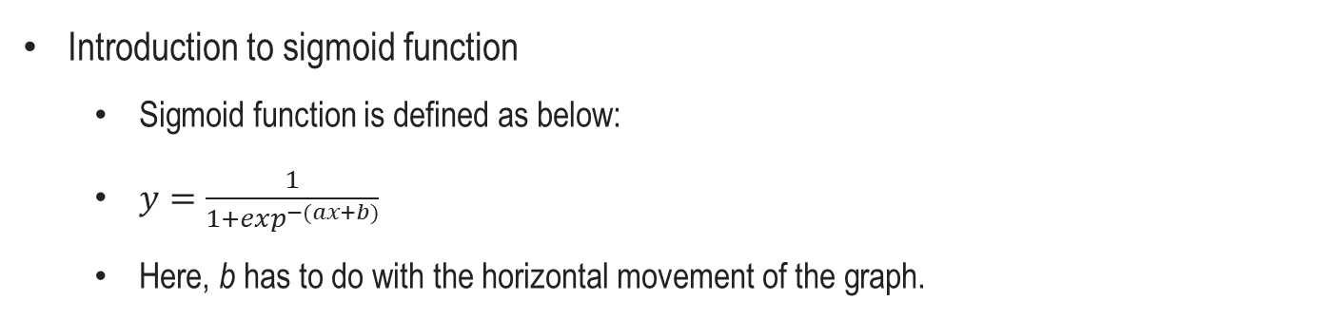
Introduction to Deep Learning Mechanisms
Introduction to sigmoid function
Sigmoid function is defined as below:
$y=\frac{1}{1+\exp^{−(ax+b)}}$
Here, b has to do with the horizontal movement of the graph.
when b is large
when b is small

Slide 36
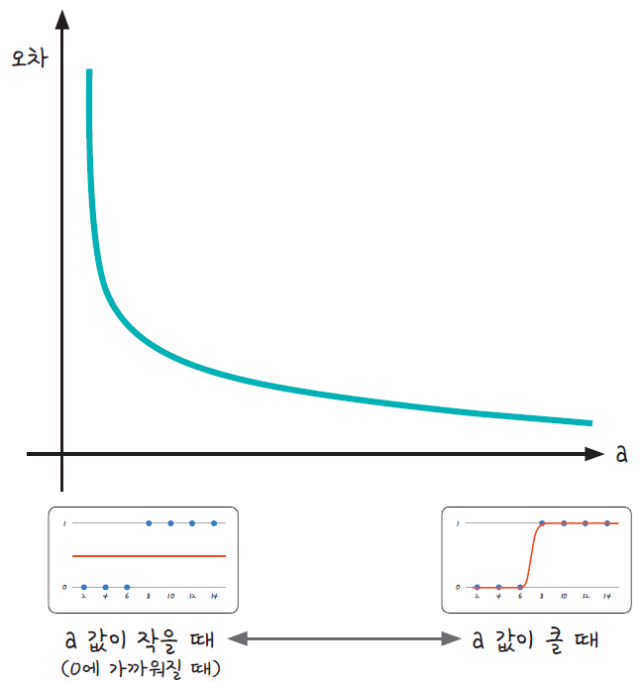
Introduction to Deep Learning Mechanisms
The relationship between sigmoid function and the error
As a decreases, the error becomes infinitely large, but as a increases, the error does not become completely zero.
error
when a is small
when a is large

Slide 37
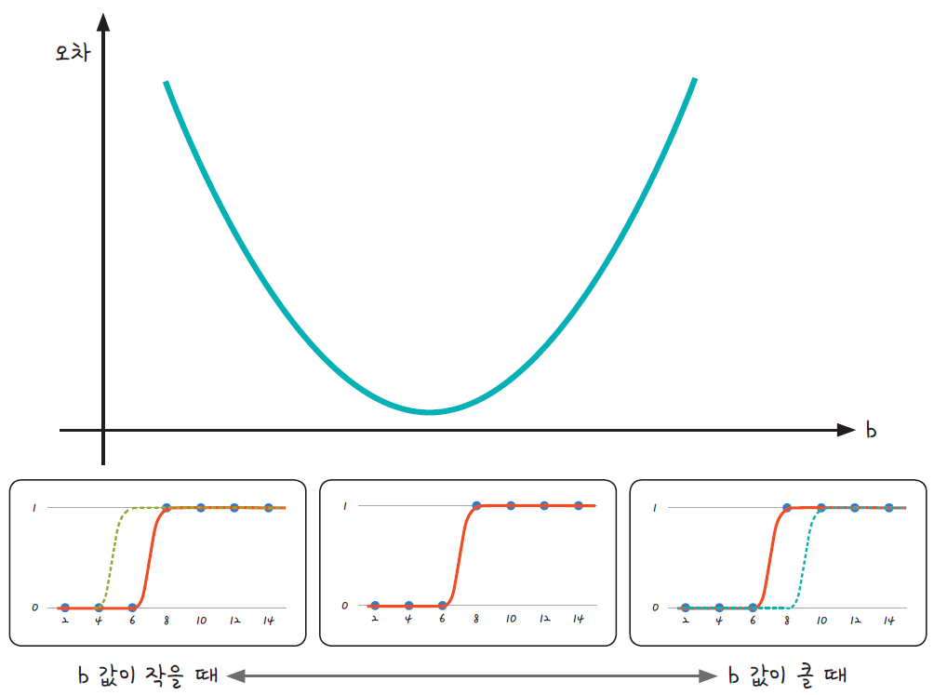
Introduction to Deep Learning Mechanisms
The relationship between sigmoid function and the error
The relationship between error and b has a U-shaped curve.
error
when b is small
when b is large

Slide 38
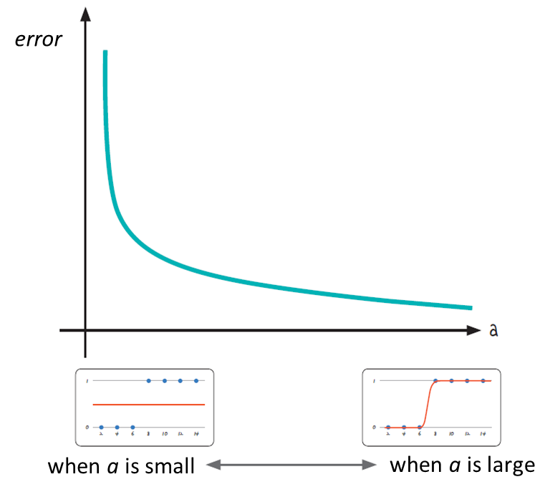
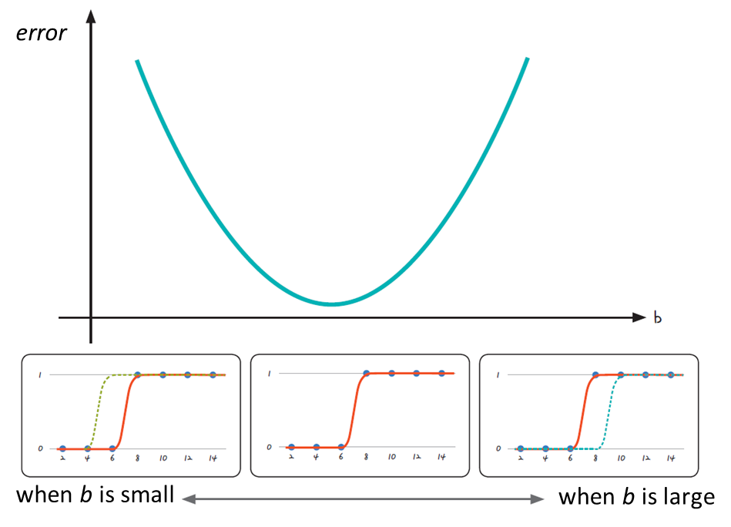
Introduction to Deep Learning Mechanisms
Introduction to binary cross entropy loss
a and b should be trained in such a way that the error is minimized.
The sigmoid function has a value between 0 and 1.

Slide 39
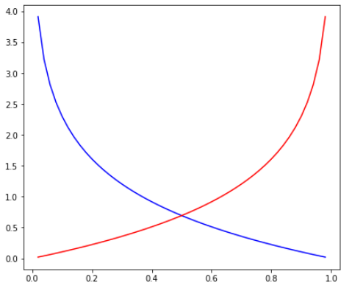
Introduction to Deep Learning Mechanisms
Introduction to binary cross entropy loss
The blue line is a graph when the actual value is 1.
When the predicted value is 1, the error is 0; conversely, the closer the predicted value is to 0, the larger the error
error
predicted
Logarithmic function graph with actual values ​​1 (blue) and 0 (red)

Slide 40
Introduction to Deep Learning Mechanisms
Introduction to binary cross entropy loss
The red line is the function when the actual value is 0
When the predicted value is 0, there is no error, and as it approaches 1, the error becomes very large.
error
predicted
Logarithmic function graph with actual values ​​1 (blue) and 0 (red)

Slide 41
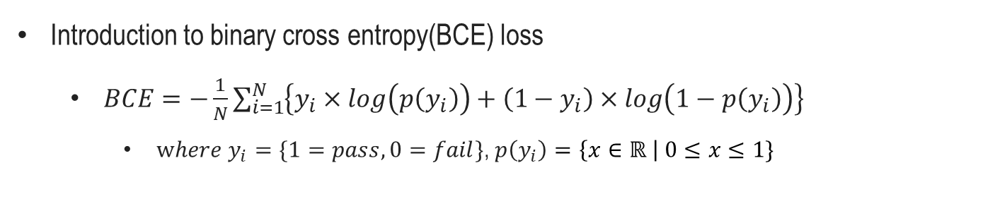
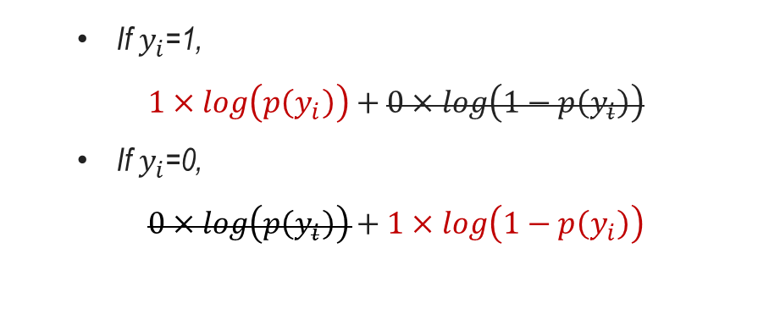
Introduction to Deep Learning Mechanisms
Introduction to binary cross entropy(BCE) loss
$BCE=−\frac{1}{N}\sum_{i=1}^{N}{\left\{y_{i}×log\left(p\left(y_{i}\right)\right)+\left(1−y_{i}\right)×log\left(1−p\left(y_{i}\right)\right)\right\}}$
$where y_{i}=\{1=pass, 0=fail\}$, $p\left(y_{i}\right)=\left\{x∈ℝ \right| 0≤x≤1\}$
If $y_{i}$=1,
$1×log\left(p\left(y_{i}\right)\right)+0×log\left(1−p\left(y_{i}\right)\right)$
If $y_{i}$=0,
$0×log\left(p\left(y_{i}\right)\right)+1×log\left(1−p\left(y_{i}\right)\right)$

Slide 42
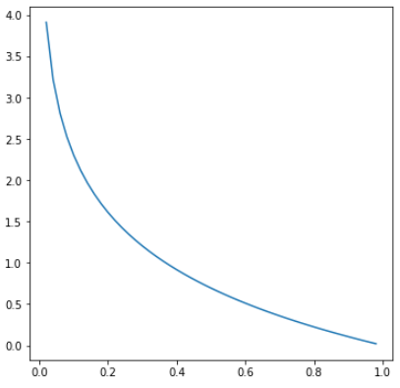
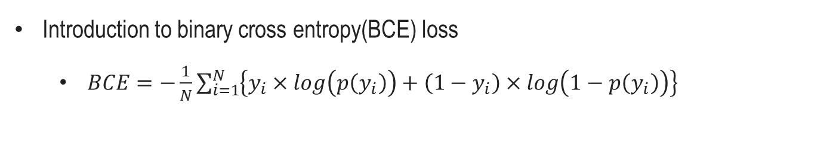

Introduction to Deep Learning Mechanisms
Introduction to binary cross entropy(BCE) loss
$BCE=−\frac{1}{N}\sum_{i=1}^{N}{\left\{y_{i}×log\left(p\left(y_{i}\right)\right)+\left(1−y_{i}\right)×log\left(1−p\left(y_{i}\right)\right)\right\}}$
If $y_{i}$=1,
$1×log\left(p\left(y_{i}\right)\right)+0×log\left(1−p\left(y_{i}\right)\right)$
error
predicted

Slide 43
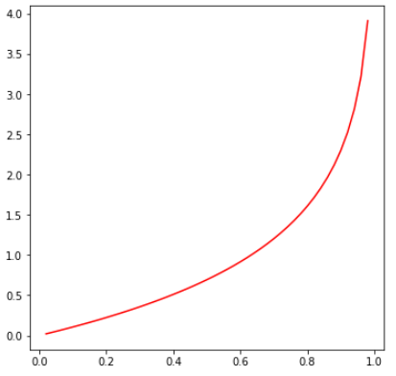

Introduction to Deep Learning Mechanisms
Introduction to binary cross entropy(BCE) loss
$BCE=−\frac{1}{N}\sum_{i=1}^{N}{\left\{y_{i}×log\left(p\left(y_{i}\right)\right)+\left(1−y_{i}\right)×log\left(1−p\left(y_{i}\right)\right)\right\}}$
If $y_{i}$=0,
$0×log\left(p\left(y_{i}\right)\right)+1×log\left(1−p\left(y_{i}\right)\right)$
error
predicted

Slide 44
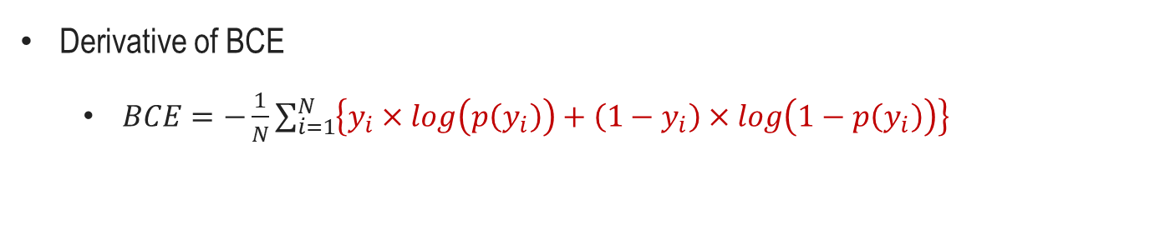
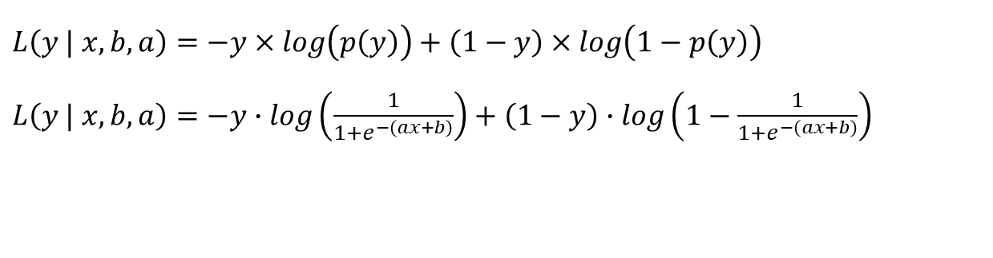
Introduction to Deep Learning Mechanisms
Derivative of BCE
$BCE=−\frac{1}{N}\sum_{i=1}^{N}{\left\{y_{i}×log\left(p\left(y_{i}\right)\right)+\left(1−y_{i}\right)×log\left(1−p\left(y_{i}\right)\right)\right\}}$
$$L\left(y | x,b,a\right)=−y×log\left(p\left(y\right)\right)+\left(1−y\right)×log\left(1−p\left(y\right)\right)$$
$L\left(y | x,b,a\right)=−y∙log\left(\frac{1}{1+e^{−\left(ax+b\right)}}\right)+\left(1−y\right)∙log\left(1−\frac{1}{1+e^{−\left(ax+b\right)}}\right)$

Slide 45

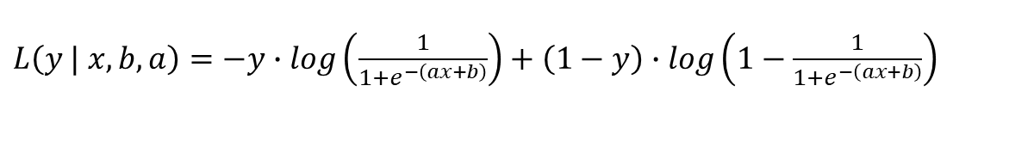
Introduction to Deep Learning Mechanisms
Derivative of BCE
$BCE=−\frac{1}{N}\sum_{i=1}^{N}{\left\{y_{i}×log\left(p\left(y_{i}\right)\right)+\left(1−y_{i}\right)×log\left(1−p\left(y_{i}\right)\right)\right\}}$
t
t
$L\left(y | x,b,a\right)=−y∙log\left(\frac{1}{1+e^{−\left(ax+b\right)}}\right)+\left(1−y\right)∙log\left(1−\frac{1}{1+e^{−\left(ax+b\right)}}\right)$
v
v
$t=\frac{1}{1+e^{−\left(ax+b\right)}}$ , $v=ax+b$

Slide 46
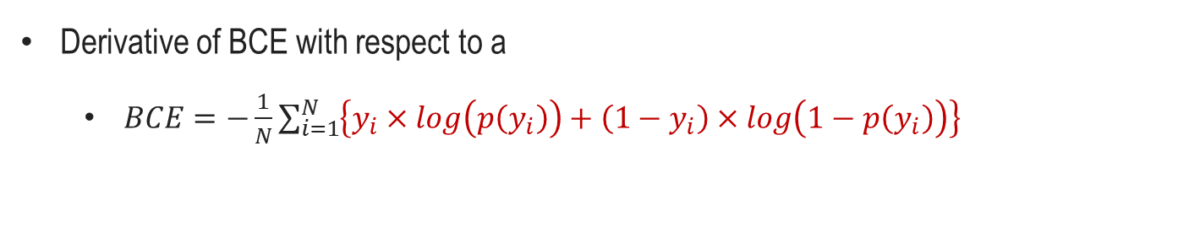


Introduction to Deep Learning Mechanisms
Derivative of BCE with respect to a
$BCE=−\frac{1}{N}\sum_{i=1}^{N}{\left\{y_{i}×log\left(p\left(y_{i}\right)\right)+\left(1−y_{i}\right)×log\left(1−p\left(y_{i}\right)\right)\right\}}$
$t=\frac{1}{1+e^{−\left(ax+b\right)}}$ , $v=ax+b$
$$\frac{∂L}{∂a}=\frac{∂}{∂a}\left(−y∙log\left(t\right)−\left(1−y\right)∙log\left(1−t\right)\right)$$
$$\frac{∂L}{∂t}\frac{∂t}{∂v}\frac{∂v}{∂a}=\frac{∂}{∂a}\left(−y∙log\left(t\right)\right)−\frac{∂}{∂a}\left(\left(1−y\right)∙log\left(1−t\right)\right)$$

Slide 47

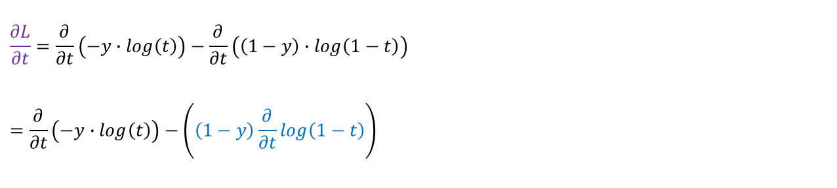
Introduction to Deep Learning Mechanisms
Derivative of BCE with respect to a
$BCE=−\frac{1}{N}\sum_{i=1}^{N}{\left\{y_{i}×log\left(p\left(y_{i}\right)\right)+\left(1−y_{i}\right)×log\left(1−p\left(y_{i}\right)\right)\right\}}$
$t=\frac{1}{1+e^{−\left(ax+b\right)}}$ , $v=ax+b$
$$\frac{∂L}{∂t}=\frac{∂}{∂t}\left(−y∙log\left(t\right)\right)−\frac{∂}{∂t}\left(\left(1−y\right)∙log\left(1−t\right)\right)$$
$$=\frac{∂}{∂t}\left(−y∙log\left(t\right)\right)−\left(\left(1−y\right)\frac{∂}{∂t}log\left(1−t\right)\right)$$

Slide 48

Introduction to Deep Learning Mechanisms
Derivative of BCE with respect to a
$BCE=−\frac{1}{N}\sum_{i=1}^{N}{\left\{y_{i}×log\left(p\left(y_{i}\right)\right)+\left(1−y_{i}\right)×log\left(1−p\left(y_{i}\right)\right)\right\}}$
$t=\frac{1}{1+e^{−\left(ax+b\right)}}$ , $v=ax+b$
$$\frac{∂L}{∂t}=\frac{∂}{∂t}\left(−y∙log\left(t\right)\right)−\frac{∂}{∂t}\left(\left(1−y\right)∙log\left(1−t\right)\right)$$
$$=\frac{∂}{∂t}\left(−y∙log\left(t\right)\right)−\left(\left(1−y\right)\frac{∂}{∂t}log\left(1−t\right)\right)$$
$Let z=1−t$, then
$\frac{∂}{∂t}\log\left(1−t\right)=\frac{∂\log\left(z\right)}{∂z}∙\frac{∂z}{∂t}$

Slide 49


Introduction to Deep Learning Mechanisms
Derivative of BCE with respect to a
$BCE=−\frac{1}{N}\sum_{i=1}^{N}{\left\{y_{i}×log\left(p\left(y_{i}\right)\right)+\left(1−y_{i}\right)×log\left(1−p\left(y_{i}\right)\right)\right\}}$
$t=\frac{1}{1+e^{−\left(ax+b\right)}}$ , $v=ax+b$
$$\frac{∂L}{∂t}=\frac{∂}{∂t}\left(−y∙log\left(t\right)\right)−\frac{∂}{∂t}\left(\left(1−y\right)∙log\left(1−t\right)\right)$$
$$=\frac{∂}{∂t}\left(−y∙log\left(t\right)\right)−\left(\left(1−y\right)\frac{∂}{∂t}log\left(1−t\right)\right)$$
$Let z=1−t$, then
$\frac{∂}{∂t}\log\left(1−t\right)=\frac{∂\log\left(z\right)}{∂z}∙\frac{∂z}{∂t}$
$$\left(1−y\right)\frac{∂}{∂t}log\left(1−t\right)=\left(1−y\right)∙\frac{1}{z}∙\left(−1\right)=−\frac{\left(1−y\right)}{\left(1−t\right)}$$
by $\frac{∂\log{z}}{∂z}=\frac{1}{z}$ , $\frac{∂\left(1−t\right)}{∂t}=−1$

Slide 50

Introduction to Deep Learning Mechanisms
Derivative of BCE with respect to a
$BCE=−\frac{1}{N}\sum_{i=1}^{N}{\left\{y_{i}×log\left(p\left(y_{i}\right)\right)+\left(1−y_{i}\right)×log\left(1−p\left(y_{i}\right)\right)\right\}}$
$t=\frac{1}{1+e^{−\left(ax+b\right)}}$ , $v=ax+b$
$$\frac{∂L}{∂t}=\frac{∂}{∂t}\left(−y∙log\left(t\right)\right)−\frac{∂}{∂t}\left(\left(1−y\right)∙log\left(1−t\right)\right)$$
$$=\frac{∂}{∂t}(−y∙log\left(t\right))−\left(\left(1−y\right)\frac{∂}{∂t}log\left(1−t\right)\right)$$
$Let z=1−t$, then
$\frac{∂}{∂t}\log\left(1−t\right)=\frac{∂\log\left(z\right)}{∂z}∙\frac{∂z}{∂t}$
$$\left(1−y\right)\frac{∂}{∂t}log\left(1−t\right)=\frac{1}{z}∙\left(−1\right)∙\left(1−y\right)=−\frac{\left(1−y\right)}{\left(1−t\right)}$$
$$\frac{∂L}{∂t}=−\frac{y}{t}+\frac{(1−y) }{(1−t)}$$
by $\frac{∂\log{z}}{∂z}=\frac{1}{z}$ , $\frac{∂\left(1−t\right)}{∂t}=−1$

Slide 51

Introduction to Deep Learning Mechanisms
Derivative of BCE with respect to a
$BCE=−\frac{1}{N}\sum_{i=1}^{N}{\left\{y_{i}×log\left(p\left(y_{i}\right)\right)+\left(1−y_{i}\right)×log\left(1−p\left(y_{i}\right)\right)\right\}}$
$t=\frac{1}{1+e^{−\left(ax+b\right)}}$ , $v=ax+b$
$$\frac{∂L}{∂a}=\frac{∂}{∂a}\left(−y∙log\left(t\right)+\left(1−y\right)∙log\left(1−t\right)\right)$$
$$\frac{∂L}{∂t}\frac{∂t}{∂v}\frac{∂v}{∂a}=\frac{∂}{∂a}(−y∙log\left(t\right)) +\frac{∂}{∂a}\left(\left(1−y\right)∙log\left(1−t\right)\right)$$

Slide 52

Introduction to Deep Learning Mechanisms
Derivative of BCE with respect to a
$BCE=−\frac{1}{N}\sum_{i=1}^{N}{\left\{y_{i}×log\left(p\left(y_{i}\right)\right)+\left(1−y_{i}\right)×log\left(1−p\left(y_{i}\right)\right)\right\}}$
$t=\frac{1}{1+e^{−\left(ax+b\right)}}$ , $v=ax+b$
$$\frac{∂t}{∂v}=\frac{∂}{∂v}\left(\frac{1}{1+e^{−v}}\right)=\frac{∂}{∂v}\left(\frac{e^{v}}{e^{v}+1}\right)$$
$f\left(v\right)=e^{v}$ , $g\left(v\right)=e^{v}+1$
$f^{′}\left(v\right)=e^{v}$ , $g^{′}\left(v\right)=e^{v}$
$$\frac{∂t}{∂v}=\frac{e^{v}∙\left(e^{v}+1\right)−e^{2v}}{{(e^{v}+1)}^{2}}=\frac{e^{v}}{{(e^{v}+1)}^{2}}$$
Quotient rule
By $F^{′}\left(x\right)={\left\{\frac{f\left(v\right)}{g(v)}\right\}}^{′}=\frac{f^{′}\left(v\right)g\left(v\right)−f(v)g^{′}\left(v\right)}{{\left[g\left(v\right)\right]}^{2}}$

Slide 53

Introduction to Deep Learning Mechanisms
Derivative of BCE with respect to a
$BCE=−\frac{1}{N}\sum_{i=1}^{N}{\left\{y_{i}×log\left(p\left(y_{i}\right)\right)+\left(1−y_{i}\right)×log\left(1−p\left(y_{i}\right)\right)\right\}}$
$t=\frac{1}{1+e^{−\left(ax+b\right)}}$ , $v=ax+b$
$$\frac{∂t}{∂v}=\frac{∂}{∂v}\left(\frac{1}{1+e^{−v}}\right)=\frac{∂}{∂v}\left(\frac{e^{v}}{e^{v}+1}\right)$$
$f\left(v\right)=e^{v}$ , $g\left(v\right)=e^{v}+1$
$f^{′}\left(v\right)=e^{v}$ , $g^{′}\left(v\right)=e^{v}$
$$\frac{∂t}{∂v}=\frac{e^{v}∙\left(e^{v}+1\right)−e^{2v}}{{(e^{v}+1)}^{2}}=\frac{e^{v}}{{(e^{v}+1)}^{2}}$$
=$\frac{e^{v}}{(e^{v}+1)}∙\frac{1}{\left(e^{v}+1\right)}=\frac{e^{v}}{\left(e^{v}+1\right)}∙\frac{e^{−v}}{\left(1+e^{−v}\right)}=\frac{e^{v}}{\left(e^{v}+1\right)}∙\left(\frac{1+e^{−v}−1}{\left(1+e^{−v}\right)}\right)$
By $F^{′}\left(x\right)={\left\{\frac{f\left(v\right)}{g(v)}\right\}}^{′}=\frac{f^{′}\left(v\right)g\left(v\right)−f(v)g^{′}\left(v\right)}{{\left[g\left(v\right)\right]}^{2}}$

Slide 54

Introduction to Deep Learning Mechanisms
Derivative of BCE with respect to a
$BCE=−\frac{1}{N}\sum_{i=1}^{N}{\left\{y_{i}×log\left(p\left(y_{i}\right)\right)+\left(1−y_{i}\right)×log\left(1−p\left(y_{i}\right)\right)\right\}}$
$t=\frac{1}{1+e^{−\left(ax+b\right)}}$ , $v=ax+b$
$$\frac{∂t}{∂v}=\frac{∂}{∂v}\left(\frac{1}{1+e^{−v}}\right)=\frac{∂}{∂v}\left(\frac{e^{v}}{e^{v}+1}\right)$$
$f\left(v\right)=e^{v}$ , $g\left(v\right)=e^{v}+1$
$f^{′}\left(v\right)=e^{v}$ , $g^{′}\left(v\right)=e^{v}$
$$\frac{∂t}{∂v}=\frac{e^{v}∙\left(e^{v}+1\right)−e^{2v}}{{(e^{v}+1)}^{2}}=\frac{e^{v}}{{(e^{v}+1)}^{2}}$$
=$\frac{e^{v}}{(e^{v}+1)}∙\frac{1}{\left(e^{v}+1\right)}=\frac{e^{v}}{\left(e^{v}+1\right)}∙\frac{e^{−v}}{\left(1+e^{−v}\right)}=\frac{e^{v}}{\left(e^{v}+1\right)}∙\left(\frac{1+e^{−v}−1}{\left(1+e^{−v}\right)}\right)$
=$\frac{e^{v}}{(e^{v}+1)}∙\left(\frac{\left(1+e^{−v}\right)}{\left(1+e^{−v}\right)}−\frac{1}{\left(1+e^{−v}\right)}\right)=\frac{1}{\left(1+e^{−v}\right)}∙\left(1−\frac{1}{\left(1+e^{−v}\right)}\right)=t(1−t)$
By $F^{′}\left(x\right)={\left\{\frac{f\left(v\right)}{g(v)}\right\}}^{′}=\frac{f^{′}\left(v\right)g\left(v\right)−f(v)g^{′}\left(v\right)}{{\left[g\left(v\right)\right]}^{2}}$

Slide 55

Introduction to Deep Learning Mechanisms
Derivative of BCE with respect to a
$BCE=−\frac{1}{N}\sum_{i=1}^{N}{\left\{y_{i}×log\left(p\left(y_{i}\right)\right)+\left(1−y_{i}\right)×log\left(1−p\left(y_{i}\right)\right)\right\}}$
$t=\frac{1}{1+e^{−\left(ax+b\right)}}$ , $v=ax+b$
$$\frac{∂L}{∂a}=\frac{∂}{∂a}\left(−y∙log\left(t\right)+\left(1−y\right)∙log\left(1−t\right)\right)$$
$$\frac{∂L}{∂t}\frac{∂t}{∂v}\frac{∂v}{∂a}=\frac{∂}{∂a}(−y∙log\left(t\right)) +\frac{∂}{∂a}\left(\left(1−y\right)∙log\left(1−t\right)\right)$$

Slide 56
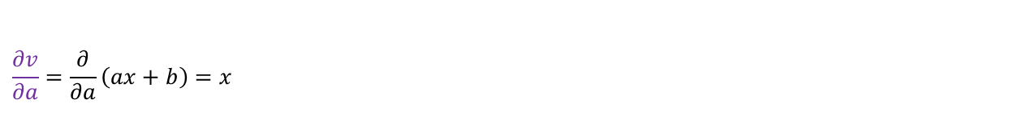
Introduction to Deep Learning Mechanisms
Derivative of BCE with respect to a
$BCE=−\frac{1}{N}\sum_{i=1}^{N}{\left\{y_{i}×log\left(p\left(y_{i}\right)\right)+\left(1−y_{i}\right)×log\left(1−p\left(y_{i}\right)\right)\right\}}$
$t=\frac{1}{1+e^{−\left(ax+b\right)}}$ , $v=ax+b$
$$\frac{∂v}{∂a}=\frac{∂}{∂a}\left(ax+b\right)=x$$

Slide 57
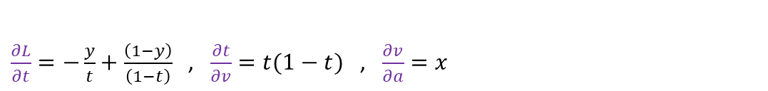
Introduction to Deep Learning Mechanisms
Derivative of BCE with respect to a
$BCE=−\frac{1}{N}\sum_{i=1}^{N}{\left\{y_{i}×log\left(p\left(y_{i}\right)\right)+\left(1−y_{i}\right)×log\left(1−p\left(y_{i}\right)\right)\right\}}$
$t=\frac{1}{1+e^{−\left(ax+b\right)}}$ , $v=ax+b$
$\frac{∂L}{∂t}=−\frac{y}{t}+\frac{\left(1−y\right)}{\left(1−t\right)}$ , $\frac{∂t}{∂v}=t(1−t)$ , $\frac{∂v}{∂a}=x$

Slide 58
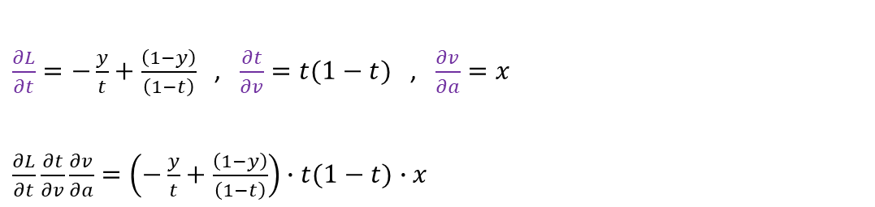
Introduction to Deep Learning Mechanisms
Derivative of BCE with respect to a
$BCE=−\frac{1}{N}\sum_{i=1}^{N}{\left\{y_{i}×log\left(p\left(y_{i}\right)\right)+\left(1−y_{i}\right)×log\left(1−p\left(y_{i}\right)\right)\right\}}$
$t=\frac{1}{1+e^{−\left(ax+b\right)}}$ , $v=ax+b$
$\frac{∂L}{∂t}=−\frac{y}{t}+\frac{\left(1−y\right)}{\left(1−t\right)}$ , $\frac{∂t}{∂v}=t(1−t)$ , $\frac{∂v}{∂a}=x$
$\frac{∂L}{∂t}\frac{∂t}{∂v}\frac{∂v}{∂a}=\left(−\frac{y}{t}+\frac{\left(1−y\right)}{\left(1−t\right)}\right)∙t(1−t)∙x$

Slide 59

Introduction to Deep Learning Mechanisms
Derivative of BCE with respect to a
$BCE=−\frac{1}{N}\sum_{i=1}^{N}{\left\{y_{i}×log\left(p\left(y_{i}\right)\right)+\left(1−y_{i}\right)×log\left(1−p\left(y_{i}\right)\right)\right\}}$
$t=\frac{1}{1+e^{−\left(ax+b\right)}}$ , $v=ax+b$
$\frac{∂L}{∂t}=−\frac{y}{t}+\frac{\left(1−y\right)}{\left(1−t\right)}$ , $\frac{∂t}{∂v}=t(1−t)$ , $\frac{∂v}{∂a}=x$
$\frac{∂L}{∂t}\frac{∂t}{∂v}\frac{∂v}{∂a}=\left(−\frac{y}{t}+\frac{\left(1−y\right)}{\left(1−t\right)}\right)∙t(1−t)∙x$
$=\left(−\frac{t(1−t)y}{t}+\frac{t(1−t)\left(1−y\right)}{\left(1−t\right)}\right)∙x$

Slide 60

Introduction to Deep Learning Mechanisms
Derivative of BCE with respect to a
$BCE=−\frac{1}{N}\sum_{i=1}^{N}{\left\{y_{i}×log\left(p\left(y_{i}\right)\right)+\left(1−y_{i}\right)×log\left(1−p\left(y_{i}\right)\right)\right\}}$
$t=\frac{1}{1+e^{−\left(ax+b\right)}}$ , $v=ax+b$
$\frac{∂L}{∂t}=−\frac{y}{t}+\frac{\left(1−y\right)}{\left(1−t\right)}$ , $\frac{∂t}{∂v}=t(1−t)$ , $\frac{∂v}{∂a}=x$
$\frac{∂L}{∂t}\frac{∂t}{∂v}\frac{∂v}{∂a}=\left(−\frac{y}{t}+\frac{\left(1−y\right)}{\left(1−t\right)}\right)∙t(1−t)∙x$
$=\left(−\frac{t(1−t)y}{t}+\frac{t(1−t)\left(1−y\right)}{\left(1−t\right)}\right)∙x$
$$=\left(−(1−t)y+t\left(1−y\right)\right)∙x=\left(−y+yt+t−yt\right)∙x$$
$\frac{∂L}{∂a}=\left(t−y\right)x$

Slide 61


Introduction to Deep Learning Mechanisms
Derivative of BCE with respect to b
$BCE=−\frac{1}{N}\sum_{i=1}^{N}{\left\{y_{i}×log\left(p\left(y_{i}\right)\right)+\left(1−y_{i}\right)×log\left(1−p\left(y_{i}\right)\right)\right\}}$
$t=\frac{1}{1+e^{−\left(ax+b\right)}}$ , $v=ax+b$
$$\frac{∂L}{∂b}=\frac{∂}{∂b}\left(−y∙log\left(t\right)+\left(1−y\right)∙log\left(1−t\right)\right)$$
$$\frac{∂L}{∂t}\frac{∂t}{∂v}\frac{∂v}{∂b}=\frac{∂}{∂b}(−y∙log\left(t\right)) +\frac{∂}{∂b}\left(\left(1−y\right)∙log\left(1−t\right)\right)$$

Slide 62


Introduction to Deep Learning Mechanisms
Derivative of BCE with respect to b
$BCE=−\frac{1}{N}\sum_{i=1}^{N}{\left\{y_{i}×log\left(p\left(y_{i}\right)\right)+\left(1−y_{i}\right)×log\left(1−p\left(y_{i}\right)\right)\right\}}$
$t=\frac{1}{1+e^{−\left(ax+b\right)}}$ , $v=ax+b$
$\frac{∂L}{∂t}=−\frac{y}{t}+\frac{\left(1−y\right)}{\left(1−t\right)}$ , $\frac{∂t}{∂v}=t(1−t)$ , $\frac{∂v}{∂b}=$1

Slide 63

Introduction to Deep Learning Mechanisms
Derivative of BCE with respect to b
$BCE=−\frac{1}{N}\sum_{i=1}^{N}{\left\{y_{i}×log\left(p\left(y_{i}\right)\right)+\left(1−y_{i}\right)×log\left(1−p\left(y_{i}\right)\right)\right\}}$
$t=\frac{1}{1+e^{−\left(ax+b\right)}}$ , $v=ax+b$
$\frac{∂L}{∂t}=−\frac{y}{t}+\frac{\left(1−y\right)}{\left(1−t\right)}$ , $\frac{∂t}{∂v}=t(1−t)$ , $\frac{∂v}{∂b}=$1
$\frac{∂L}{∂t}\frac{∂t}{∂v}\frac{∂v}{∂a}=\left(−\frac{y}{t}+\frac{\left(1−y\right)}{\left(1−t\right)}\right)∙t(1−t) =\left(−\frac{t(1−t)y}{t}+\frac{t(1−t)\left(1−y\right)}{\left(1−t\right)}\right)$

Slide 64

Introduction to Deep Learning Mechanisms
Derivative of BCE with respect to b
$BCE=−\frac{1}{N}\sum_{i=1}^{N}{\left\{y_{i}×log\left(p\left(y_{i}\right)\right)+\left(1−y_{i}\right)×log\left(1−p\left(y_{i}\right)\right)\right\}}$
$t=\frac{1}{1+e^{−\left(ax+b\right)}}$ , $v=ax+b$
$\frac{∂L}{∂t}=−\frac{y}{t}+\frac{\left(1−y\right)}{\left(1−t\right)}$ , $\frac{∂t}{∂v}=t(1−t)$ , $\frac{∂v}{∂b}=$1
$\frac{∂L}{∂t}\frac{∂t}{∂v}\frac{∂v}{∂b}=\left(−\frac{y}{t}+\frac{\left(1−y\right)}{\left(1−t\right)}\right)∙t(1−t) =\left(−\frac{t(1−t)y}{t}+\frac{t(1−t)\left(1−y\right)}{\left(1−t\right)}\right)$
$$=\left(−(1−t)y+t\left(1−y\right)\right)=\left(−y+yt+t−yt\right)$$
$\frac{∂L}{∂b}=\left(t−y\right)$

Slide 65
Introduction to Deep Learning Mechanisms
Coding exercise for GD with BCE
https://colab.research.google.com/github/JunetaeKim/DeepLearningClass/blob/main/Week5/W5_GradientDecsent_BCE.ipynb

